Slide 1
Systems Analysis and Design 11th Edition
Toolkit A – The Systems Analyst’s Toolkit Communication Tools

Slide 2
Chapter Objectives
List overall guidelines for successful communications
Write effective letters, memos, and e-mail messages
Measure the readability of written material
Organize and prepare written reports that are required during systems development

Slide 3
Chapter Objectives (Cont.)
Follow guidelines for effective oral communication
Plan, develop, and deliver a successful presentation
Use effective speaking techniques to achieve your objectives
Manage and strengthen your communication skills

Slide 4
Successful Communication Strategies
Why, Who, What, When and How
Important questions that one must answer before communicating
Why - Know the reason behind the communication, and what needs to be accomplished
Who - Know the targets are and their information needs
What - Know what is expected and when to go into detail

Slide 5
Successful Communication Strategies (Cont. 1)
When - Know when to speak and when to remain silent
How - Strengthen communication skills by:
Using Toolkit suggestions
Reflecting upon one’s own experiences
Observing successful and unsuccessful techniques used by others

Slide 6
Successful Communication Strategies (Cont. 2)
Cultural Context
Cultural factors include geography, background, educational level, and societal differences
Differences and corporate culture must be considered when asking and answering questions
Know Your Subject
One’s credibility and effectiveness depend on the support one receives on his/her views
Adopt a specific preparation strategy

Slide 7
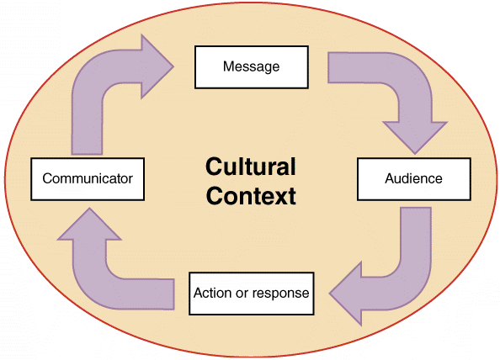
Successful Communication Strategies (Cont. 3)
FIGURE A-1 Every communication takes place within an overall cultural context.

Slide 8
Written Communications
Writing Style and Readability
Know the audience
Use active voice whenever possible
Keep writing clear, concise, and well-organized
Use an appropriate style
Use lists and short, easy-to-understand words
Avoid repeating the same word too often and use a spell checker
Ensure that written content is grammatically error-free
Conduct a careful review of the work done

Slide 9
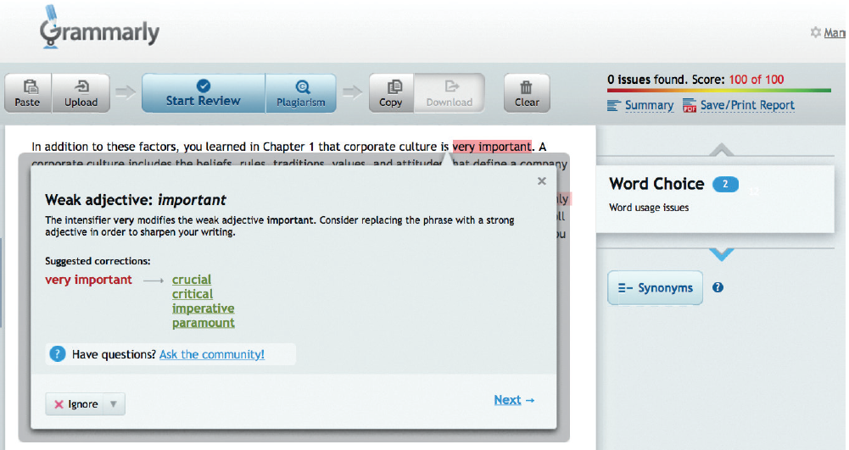
Written Communications (Cont. 1)
FIGURE A-2 Grammarly is a sophisticated tool for checking grammar that works with Microsoft Office or within a browser.
Source: Grammarly Inc.

Slide 10
Written Communications (Cont. 2)
Readability: Analyzes ease of comprehension by measuring specific characteristics of syllables, words, and sentences
Readability measures
Flesch Reading Ease score: Measures the average sentence length and the average number of syllables per word and rates the text on a 100-point scale
Flesch-Kincaid Grade Level Score: Formula used produces a rating keyed to a U.S. grade-school level

Slide 11
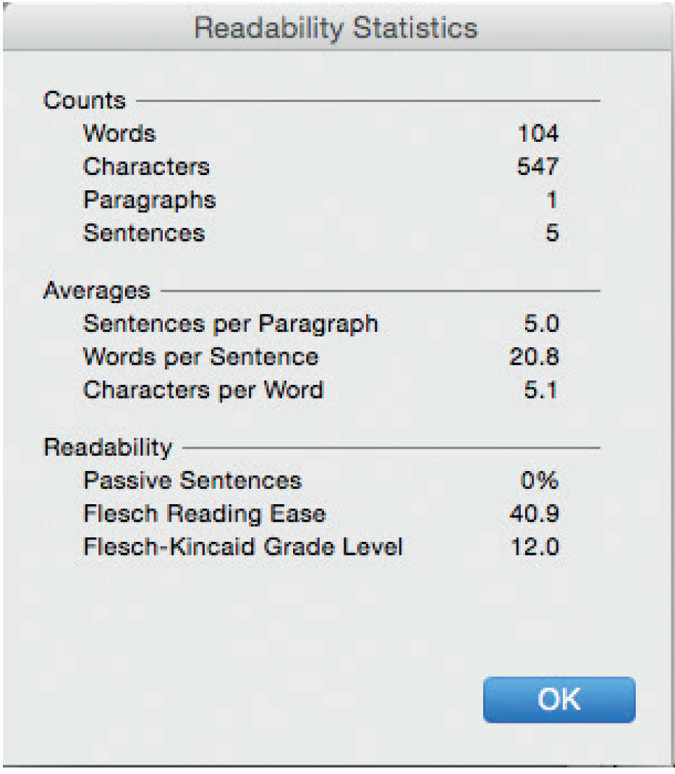
Written Communications (Cont. 3)
FIGURE A-3 Microsoft Word offers Readability Statistics that include the Flesch Reading Ease score and the Flesch-Kincaid Grade Level score.
Source: Microsoft Word 2011 for Mac

Slide 12
Written Communications (Cont. 4)
E-Mail, Memos, and Letters
E-mail is less formal than other written correspondence
Rules of good grammar, correct spelling, and clear writing apply
Create a distribution list that includes specific members and their e-mail addresses
External communications often require letters printed on company letterhead
Using a template provides a consistent look and makes writing e-mails easier

Slide 13
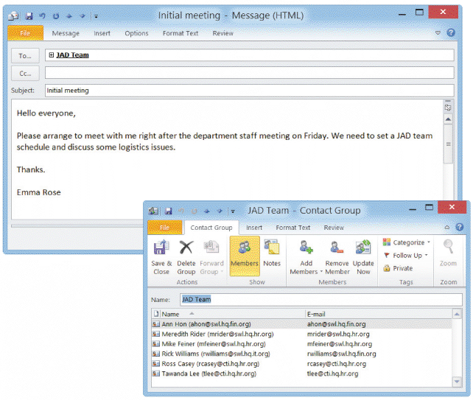
Written Communications (Cont. 5)
FIGURE A-4 Microsoft Outlook allows users to create distribution lists for sending e-mail messages.

Slide 14
Written Communications (Cont. 6)
Social Media at Work
The backdrop
Social media is used in corporate marketing plans to create excitement, call attention to products, and reach out to a young, active, and socially aware market
Advantages
IT professionals can use social media to network with others, find out about new technology, meet colleagues, discuss career issues, and maintain a Web-based presence
Risk – One should know and understand his/her company’s social media policies

Slide 15
Written Communications (Cont. 7)
Ways to get fired
Bragging about a new marketing strategy before it has been publicly announced
Being somewhere or doing something that might degrade the company’s image
Launching an angry verbal attack on fellow employees or managers
Other issues
Use a “need to know” approach
Avoid blanket messaging and broadcasting
Consider the appropriateness of the content being used for the site
Exercise good judgement and common sense

Slide 16
Written Communications (Cont. 8)
Netiquette: Combination of the words Internet and etiquette
Rules and tips
Always fill in the subject field with a brief description of the contents
Be brief and professional
Use spellcheck
Don’t forward jokes or chain letters without the permission of the recipient
Don’t overuse humor or sarcasm that might work in a face-to-face situation, but not in an e-mail
Don’t type in all caps

Slide 17
Written Communications (Cont. 9)
Don’t use colored fonts, background, or images
Don’t use the return receipt request feature unless there is a valid business reason to do so
If you have large attachment files, try to zip or compress them before sending
Never give out personal information without the individuals specific approval to do so
Workgroup Software or Groupware
Enhances employee productivity and teamwork
Enables users in organizing tasks, schedules, and documents
Examples - Google Docs and Adobe Acrobat

Slide 18
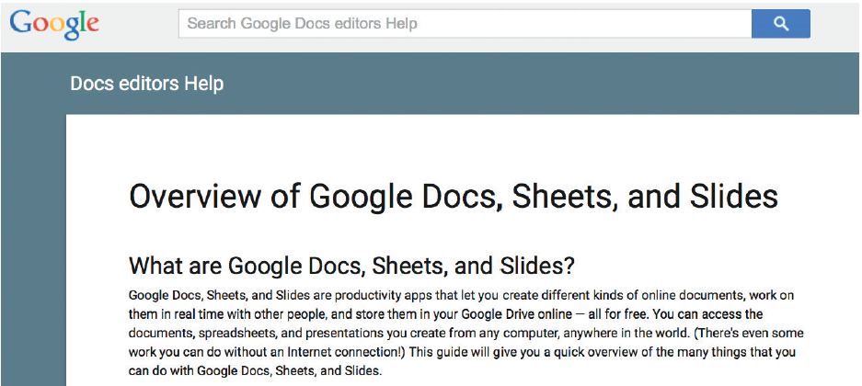
Written Communications (Cont. 10)
FIGURE A-6 Google Docs supports collaborative work on documents stored in the cloud.
Source: Google Inc.

Slide 19
Written Communications (Cont. 11)
Reports
Reports required during systems development
Preliminary investigation report
System requirements document
System design specification
Final report to management
Status reports, activity reports, proposals, and departmental business plans
PDF files are flexible, compatible, and more secure than other documents

Slide 20
Written Communications (Cont. 12)
Contain the following sections
Introduction
Executive summary
Findings
Recommendations
Costs and benefits
Appendix

Slide 21
Oral Communications
Oral presentations are required at the:
End of the preliminary investigation
Conclusion of the systems analysis phase
Define the Audience
Chances of success improve when the presentation is designed as per the expectations of the audience
Define the Objectives
Inform management about the status of the current system
Describe findings concerning the current system problems

Slide 22
Oral Communications (Cont. 1)
Explain the alternative solutions developed
Provide detailed cost and time estimates for the alternative solutions
Recommend the best alternative and provide supporting facts
Organize the Presentation
Stages in a presentation – Introduction, information, and summary
Define Any Technical Terms
Define unfamiliar terms or use alternative ways to help the audience understand presented material

Slide 23
Oral Communications (Cont. 2)
Prepare Presentation Aids
Visual aids help present information using graphics
Presentations can be enhanced by using aids such as overhead transparencies and videotapes
Ensure that the content is clear and easy to understand
Presentation software
Examples - Microsoft PowerPoint and Apple Keynote
Guidelines to preparing a slideshow
Prepare an overall outline
Maintain a balance between providing too much and too little information
Follow the 7 by 7 rule or the 6 by 6 rule

Slide 24
Oral Communications (Cont. 3)
When displaying a list of items, consider using a series of slides to add each point sequentially and use bullets rather than numbers
Choose easily readable fonts
Use appropriate point sizes for titles and body text
Select special effects carefully and include tables or graphics
Strive for a consistent look and feel
Avoid reading slides to the audience
Deliver a presentation that can be viewed easily from anywhere in the room

Slide 25
Oral Communications (Cont. 4)
Practice
Rehearse well and avoid using a script
The Presentation
Sell yourself and your credibility
Control the presentation
Maintain the pace of the presentation
Answer questions appropriately
Listen carefully and respond with a straightforward answer
Try to anticipate the questions that the audience will ask

Slide 26
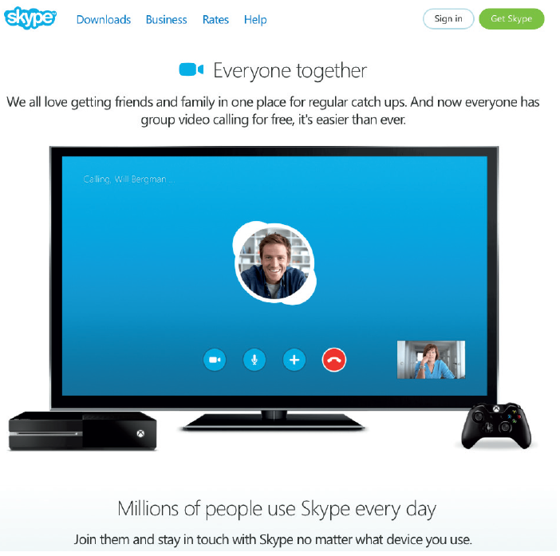
Oral Communications (Cont. 5)
Use effective speaking techniques
Speak clearly and confidently
Suggestions for nervous speakers
Control the environment
Think of nervousness as normal pressure
Avoid meaningless filler words
Practice
Online Presentations
Communication between the presenter and the audience may occur
FIGURE A-11 Skype is a free cross-platform communication and collaboration tool that is widely used.
Source: http://www.skype.com [owned by Microsoft]

Slide 27
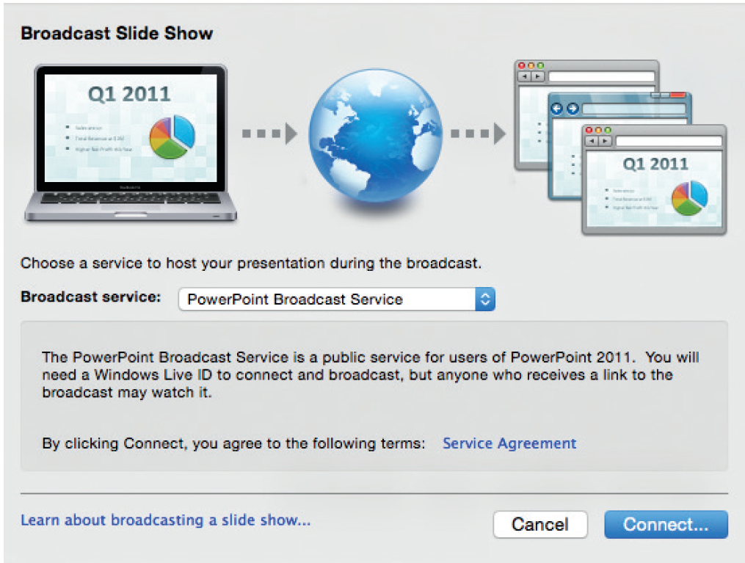
Oral Communications (Cont. 6)
FIGURE A-9 Microsoft PowerPoint lets you broadcast your presentation to a remote audience.
Source: Microsoft PowerPoint 2011 for Mac

Slide 28
Managing Your Communication Skills
Individuals can improve their communication skills by practicing constantly
Some people find it difficult to stand in front of a group and deliver a presentation or report
Toastmasters offers a friendly environment where members:
Critique each speech in a positive manner
Identify strengths and offer suggestions about what might be improved

Slide 29

Managing Your Communication Skills (Cont.)
FIGURE A-12 Toastmasters is one of the oldest organizations dedicated to helping individuals become more
effective communicators.
Source: Toastmasters International.

Slide 30
Toolkit Summary
The success of systems analysts depend on their ability to communicate effectively
Ensure that written work is free of grammatical, punctuation, and spelling errors
Social media allows informal, interactive, and immediate communication
Use readability measurement tools such as the Flesch Reading Ease score and the Flesch-Kincaid Grade Level score
The format of the various reports required during the systems development phase vary according to the nature of the report

Slide 31
Toolkit Summary (Cont.)
One may have to deliver presentations to different audiences at different times during the SDLC
When developing presentations, follow the 6 by 6 rule or 7 by 7 rule
When delivering presentations, one is selling his/her ideas and credibility
Every IT professional should have a strategic plan to manage and improve written and oral communication skills

